Slide 1
CRUCIAL: CryoSat-2 Success over Inland Water and Land: Preliminary Inland Water Heights and Validation
P Moore¹, P.A.M.Berry¹, R. Balmbra¹, S. Birkinshaw¹, C.G.Kilsby¹, P. Bauer-Gottwein², S. Dinardo³, B.M. Lucas⁴, J. Benveniste⁵
¹School of Civil Engineering and Geosciences, Newcastle University, UK; ²Technical University of Denmark, ³Serco/ESRIN, Italy, ⁴Deimos/ESRIN, Italy, ⁵ESA/ESRIN, Italy
AGU Fall 2014: H33P: Remote Sensing Applications
for Water Resources Management I

Slide 2
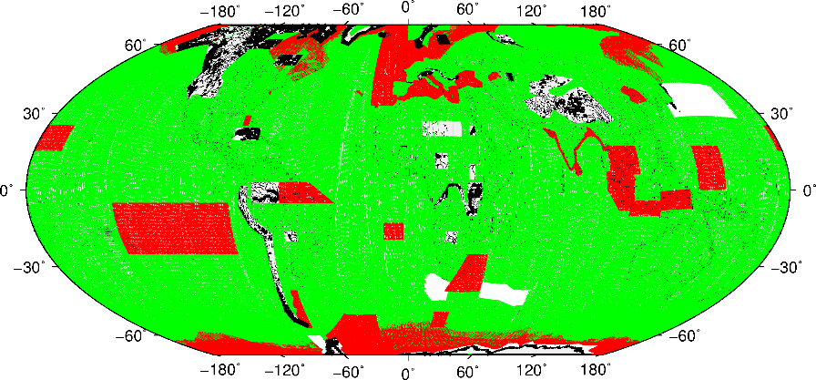
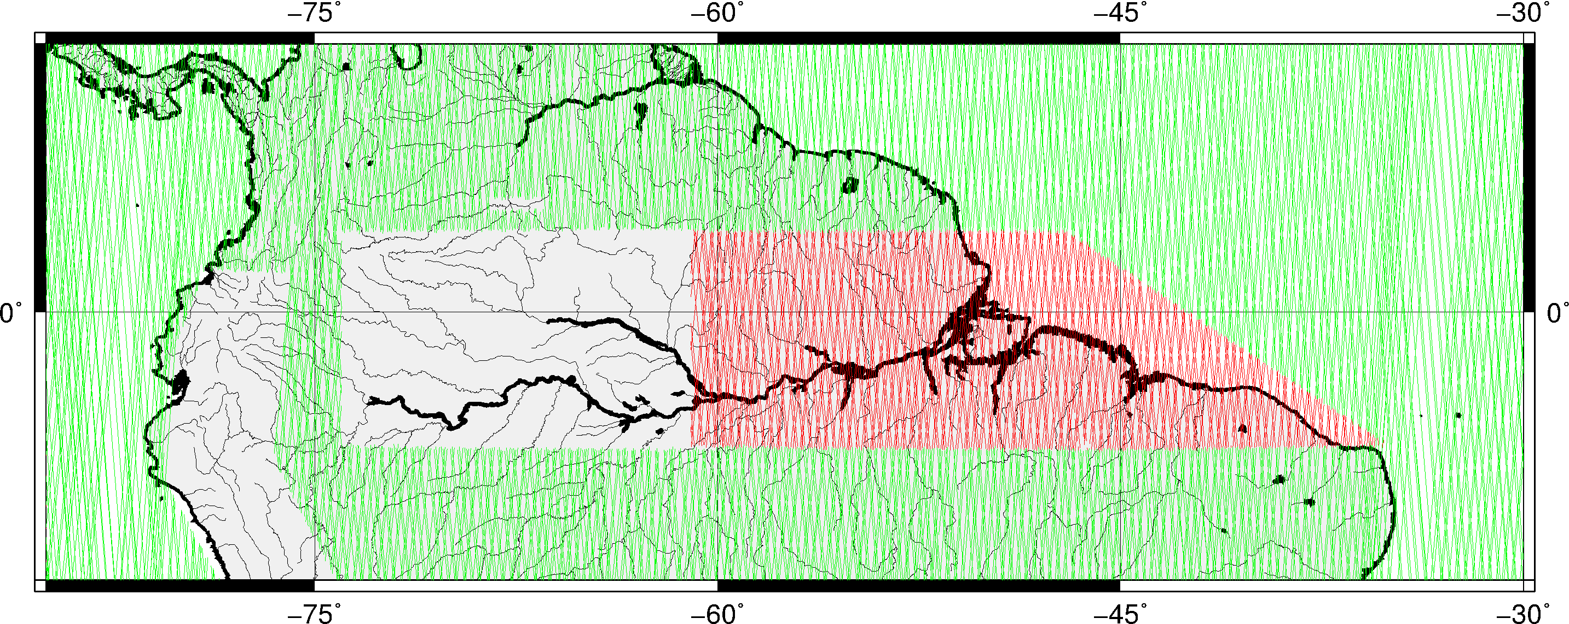
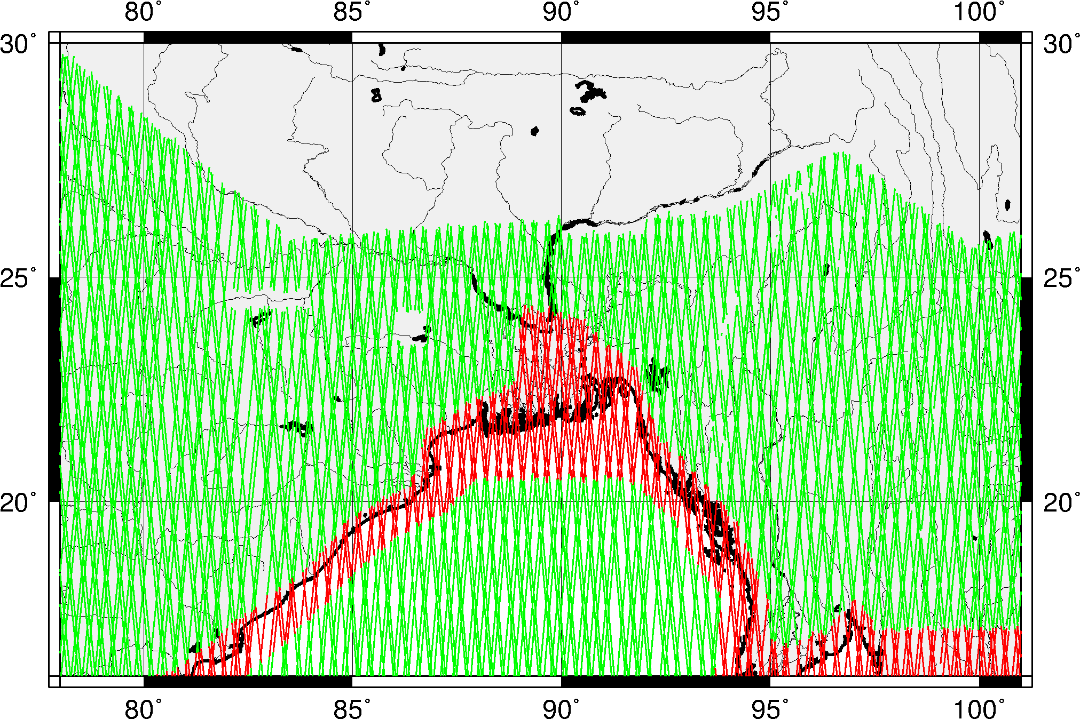
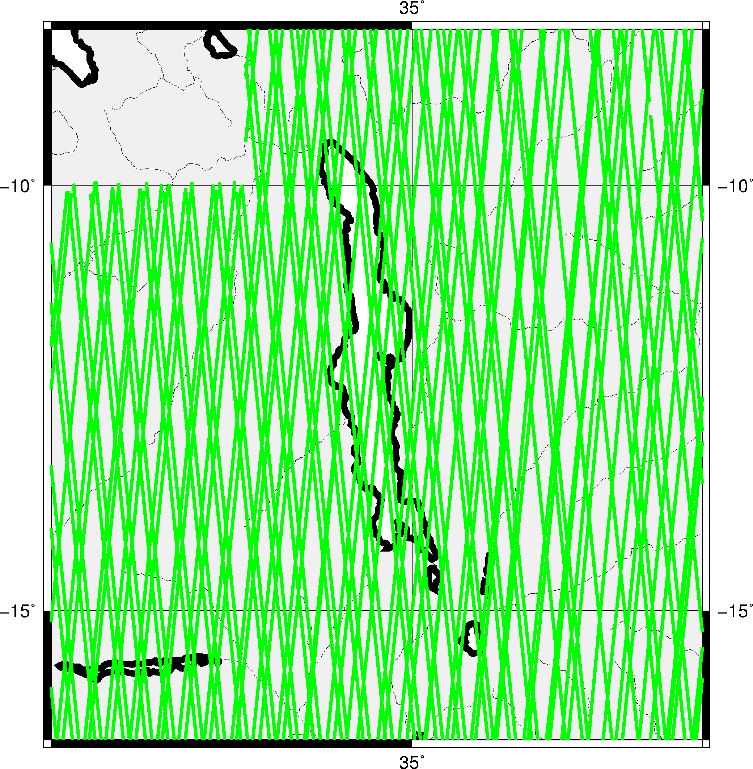
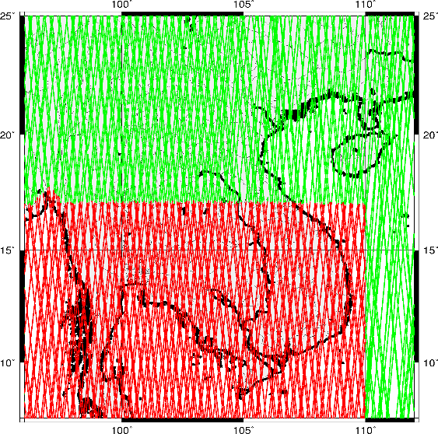
CryoSat-2 SIRAL mode: LRM, SAR, SARin
Global
Amazon
Brahmaputra
Lake Malawi
Mekong
Notes:
Plots of Cryots2 SIRAL modes: Global and regional test locations

Slide 3
Status:
One year of Cryosat2 SAR L1B and LRM data pre-processed over inland water targets
Waveform shapes analysed and behaviour with terrain and water distribution investigated
New SAR retracker (BER1) development underway (progress reported here)
Hydrological modelling with Cryosat2 started for the Brahamaputra
Analysis of SAR FBR data for inland water studies initiated
Primary Retracker Targets
LRM (complex targets but viable)
Lakes Malawi (Geoid issue with Moho) and Lake Tana (source of Blue Nile, Ethiopia)
SAR
Amazon Basin
Validation
Brahmaputra and Mekong
Notes:
BER stands for Berry Expert Retracker

Slide 4
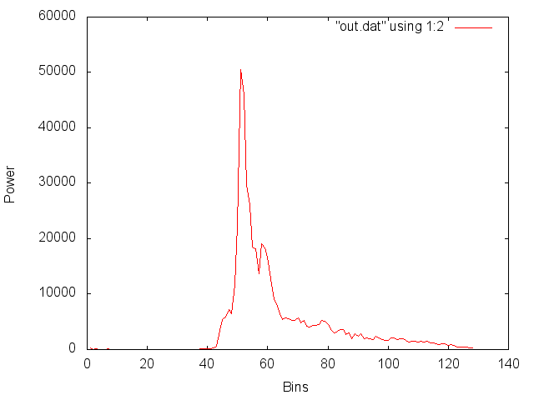
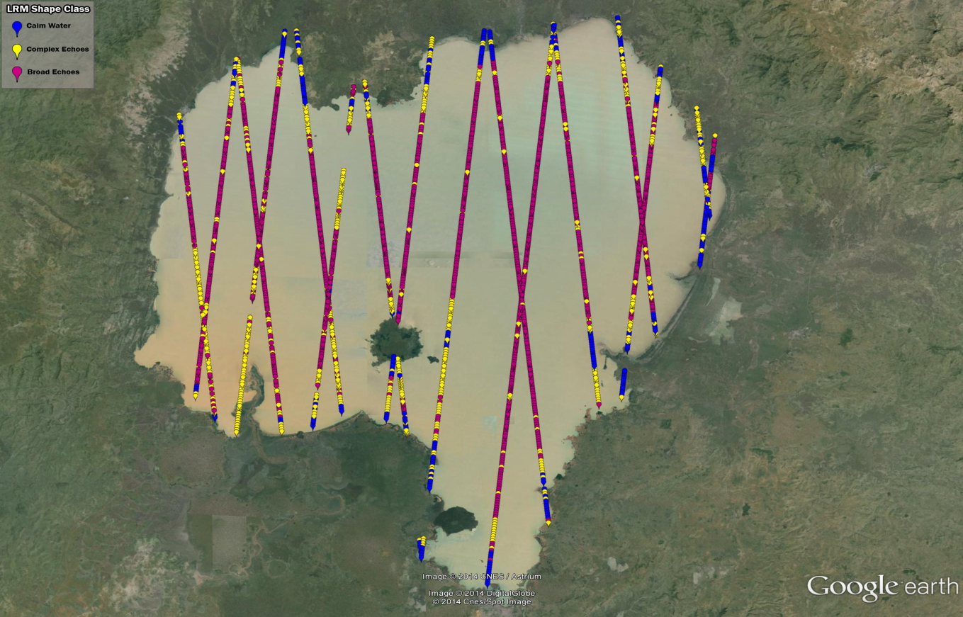
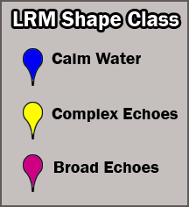
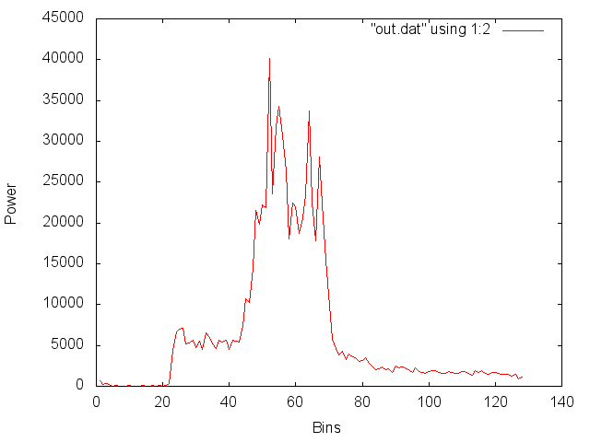
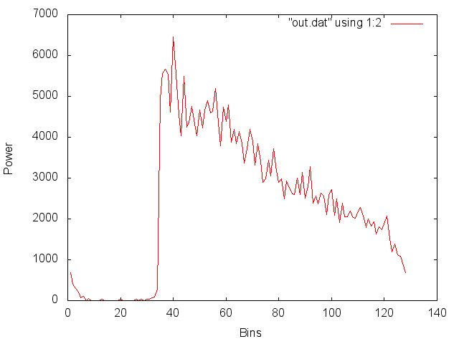
Cryosat2 LRM tracks across Lake Tana:
Waveform shape classification
Shallow lake, 4m average depth, changes considerably in spatial extent. Complex waveforms can occur especially near lake boundaries.
Notes:
LRM waveform shape classification across Lake Tana. Calm water shapes at lake edge; broad echoes in interior; complex echoes probably a mixture of calm and ruffled waters and land.

Slide 5
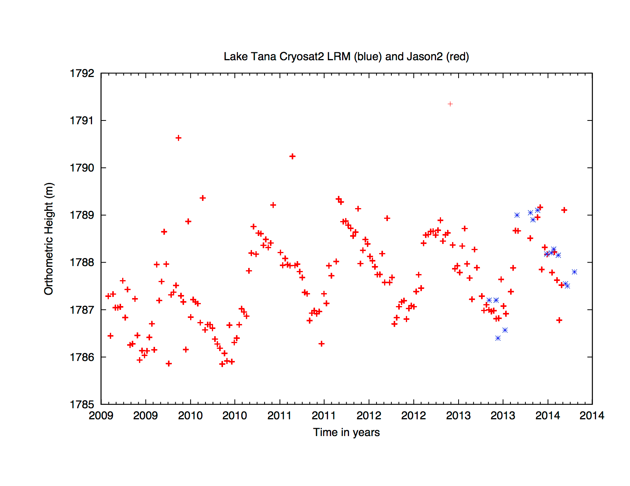
LRM height comparison across Lake Tana
Historically, good altimetric target. Jason-2 successfully measures the surface, giving potential for validation time-series comparison
Comparison of CryoSat-2 LRM heights (blue) and Jason-2 heights (red)
Insufficient data for statistical analysis but broad agreement.
Notes:
Comparison of Cryosat2 and Jason-2 heights over Lake Tana. Confirmation of seasonal cycle.

Slide 6
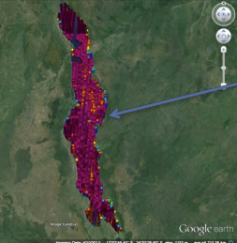
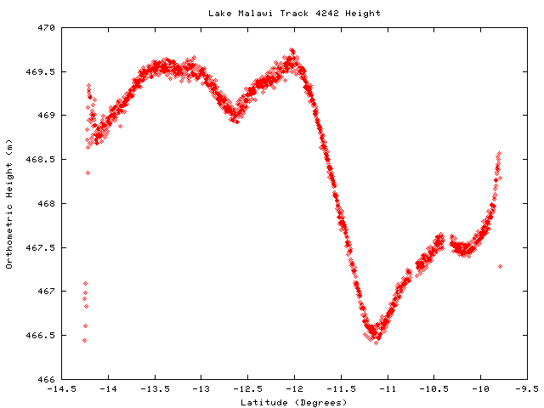
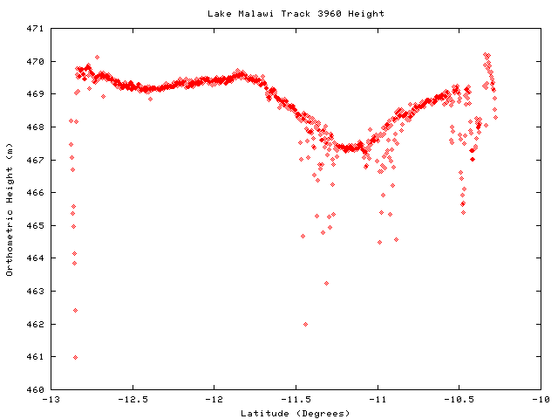
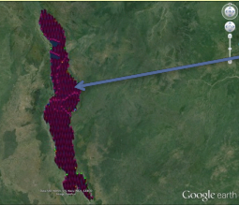
Lake Malawi
One year of echo shapes from CryoSat-2 LRM mode.
‘Pink’ echoes are broad echoes with fairly low power returns typical of shapes from previous missions. Not quite classical ocean echoes, but representative of returns from echoes with some wave structure. ‘Orange’ are anomalous wide echo shapes, probably echoes that were not completely captured.
For comparison, one of echo shapes from ERS1 Geodetic Mission. Differences from CryoSat-2 as ERS-1 was in ‘ice mode’ with the wider range window capturing all of the echo shape.
Two CryoSat-2 tracks across
Lake Malawi. Variation (3-4 m) due to high frequency geoid associated with Moho
Notes:
The Cryosat-2 passes represent the lake heights. The top track shows variation of 4 m. This is due to the geoid variation associated with the Moho

Slide 7
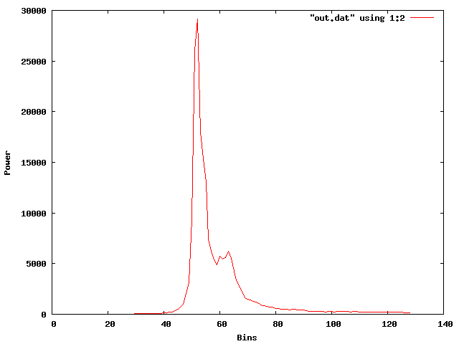
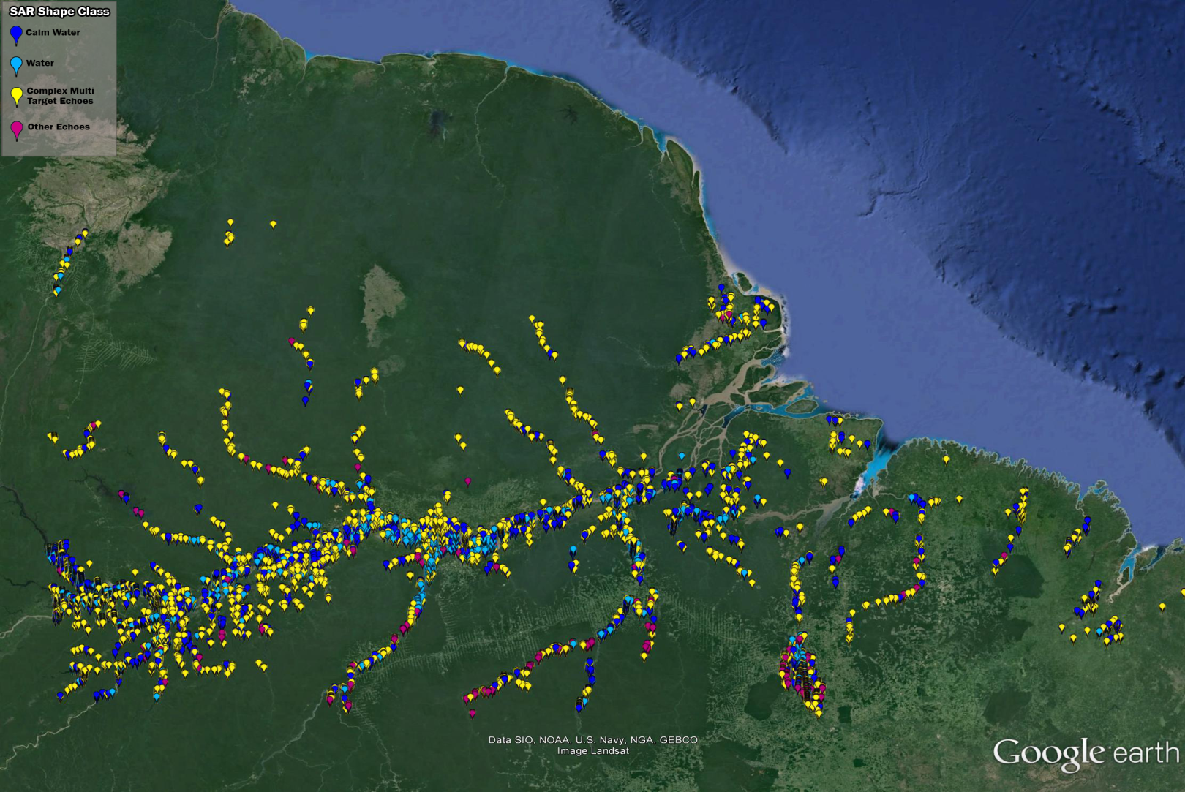
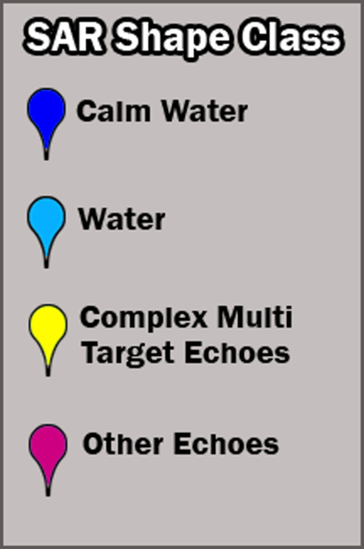
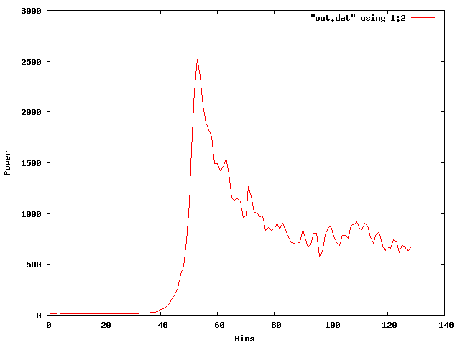
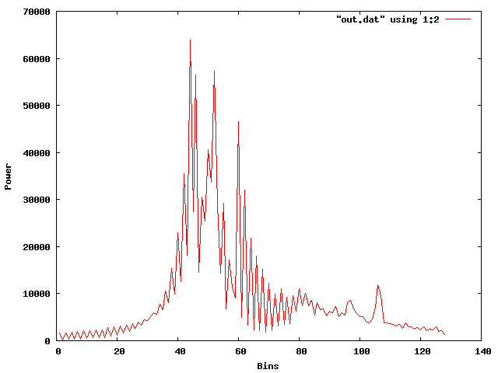
CryoSat-2 SAR L1B (Kiruna) tracks across Amazon basin:
Waveform shape classification
Notes:
SAR L1b Kiruna (20Hz). Note preponderance of complex echoes with relatively few water (ie ocean-like) and calm water echoes. Some useful data is available but preponderance suggests that enhancements to FBR processing required.

Slide 8
Echo Classification Status
Waveform behaviour understood on LRM and SAR modes
Multi-target echoes over river systems endemic.
High proportion of complex echoes caused by
Off-ranging to bright targets from still water not on river
Interruptions to water surfaces e.g. sandbanks
Complexity of surrounding terrain
Filtering Protocol Defined
Initially severe but relax as development allows more complex echoes to be decoded
Using severe/seasonal masks of river courses unlikely to be successful as
Ephemeral interruption to water flow occurs near minimum flow
Approach requires rivers to behave predictably (no floods/droughts)
Small number of echoes risks losing crossings if mask too severe
Waveform characterisation and filtering has always given better outcomes and is approach pursued here
Retracking Developments for SAR echoes
Data over Amazon to get sufficient extent to evaluate retracking performance
Novel retracker BER1 developed and in testing (preliminary results to follow)
SAR L1A data to be processed to produce high rate inland water waveforms
Notes:
Summary of LRM/SAR L1B (Kiruna) analysis and inferences to date.

Slide 9
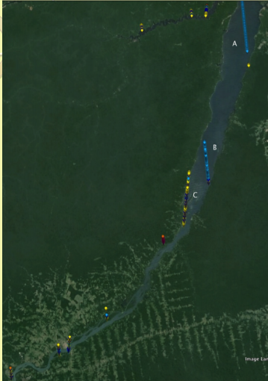
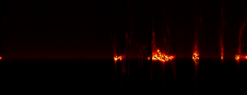
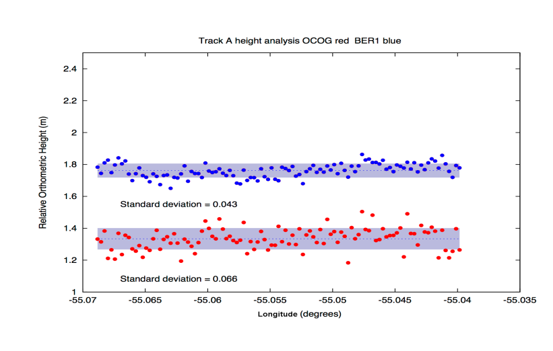
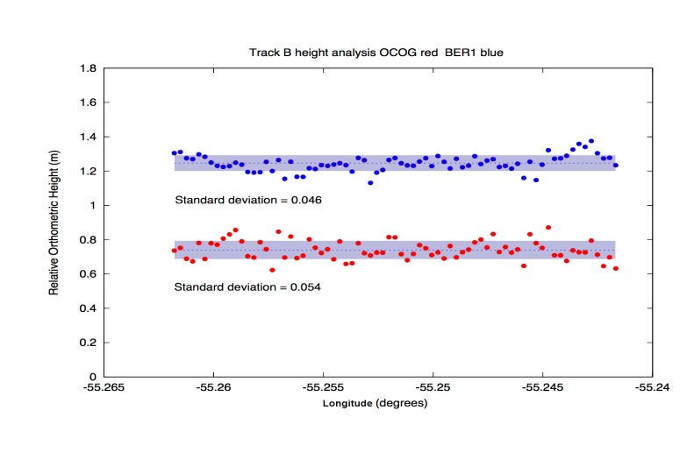
SAR L1B Tracks across Amazon tributary 1:
A
Track A
Track B
Upper: power in waveform across the tracks (not to scale).
Lower: Filtered points based on waveform shape. Artificial offset introduced.
RMS (cm)
BER1 OCOG
A: 4.3 6.6
B: 4.7 5.4
B
Notes:
Two tracks across Amazon tributary. Upper plots: shows the reflective power of the target. Lower plots: heights from the BER1 (blue) and OCOG
Trackers. Using filtering based on waveform shape the BER1 heights have 4-5 cm rms. Track A 50% improvement over OCOG. Track B BER1 performs quite well on complex track. Improved echo shape discrimination should further enhance performance as some echo shapes slightly anomalous

Slide 10
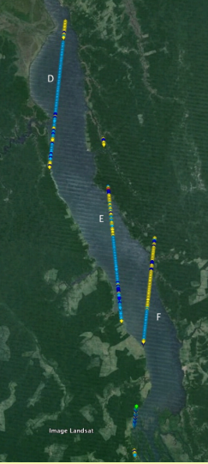
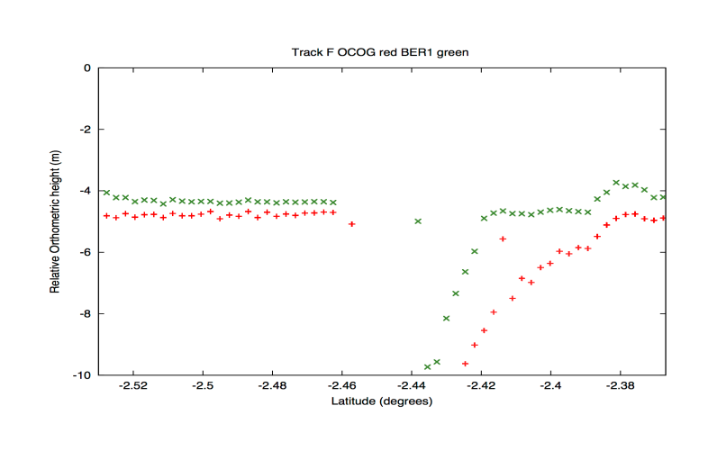
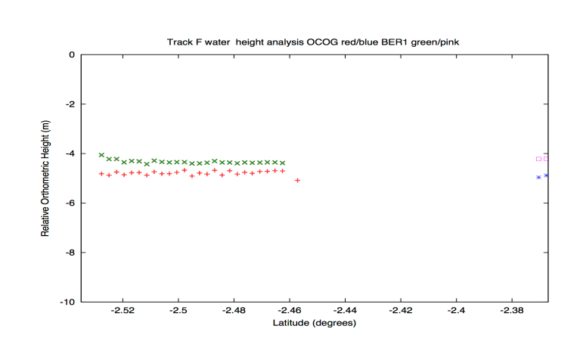
SAR L1B Tracks across Amazon tributary 2:
Track F
Track F. Illustrative of an interesting outcome. Ber1 (green) holds on to more correct surface whilst OCOG (red) off ranging (upper right). Filtering of waveform shape removes all off-ranging echoes (lower right) including the consistent BER1 heights. More research needed to retain more echoes.
F
Notes:
AS in previous slide but for a track that is less amenable to retracking

Slide 11
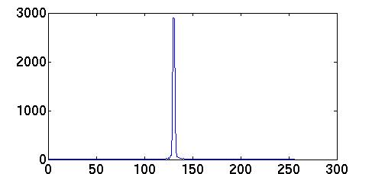
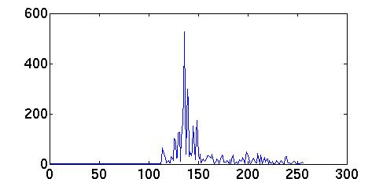
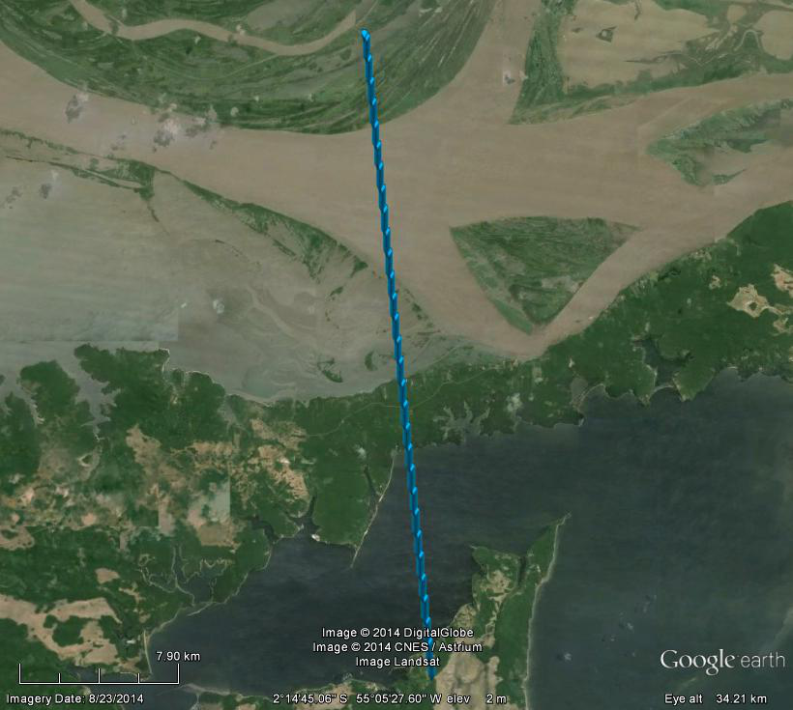
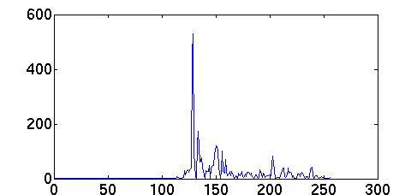
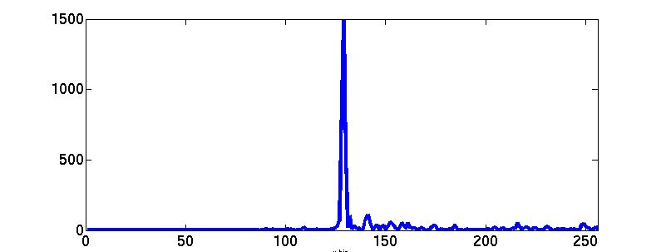
SAR FBR L1a processing:
Illustrate for pass across Amazon
Single waveform in nadir direction per burst (at burst centre), every 86 m alongtrack
No stacking (to be done)
No multi-looking (NOT applicable for small inland water targets)
Notes:
The waveforms from N to S, are specular, water, water and specular. The most northerly specular response due to stationary water; next 2 are usable, the most southerly is calm water (specular but of half power than for stationary water). Job now is to attempt to disentangle the off pointing artefacts to recover more usable waveforms and hence heights

Slide 12
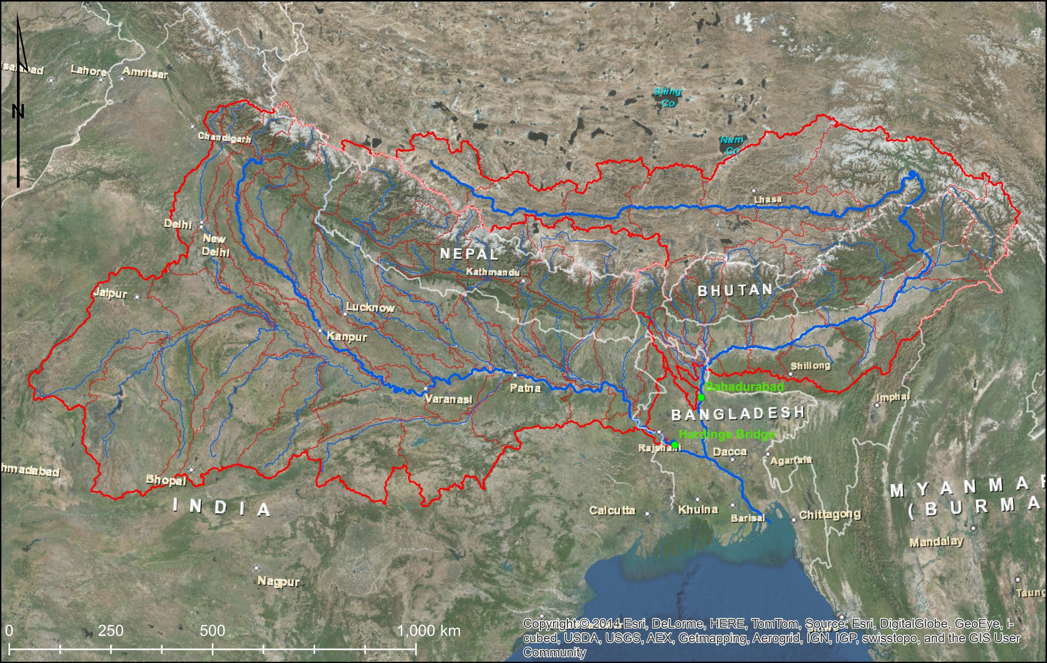
Hydrological modelling with CryoSat-2:
Case study: Ganges-Brahmaputra river basin in South Asia
Notes:
-This model is set up to support regional-scale water resources management in the region.
-It covers the Ganges basin down to the station Hardinge Bridge and the Brahmaputra basin down to the station Bahadurabad

Slide 13
Ganges-Brahmaputra Mike-11 model - Setup
87 subcatchments: NAM rainfall-runoff model (conceptual, lumped)
Hydrodynamic river routing solving Saint Venant equations using conceptual river cross sections
Mainly remote sensing data driven (TRMM 3B42 v7 precipitation)
In-situ discharge data for calibration for
some subcatchment outlets
main outlets of Ganges and Brahmaputra (stations Hardinge Bridge and Bahadurabad)
Notes:
These are key technical characteristics on the hydrologic-hydrodynamic model.
-The rainfall-runoff model is a lumped-conceptual model operating on 87 sub-catchments (spatial sub-units)
-The hydrodynamic model is a 1D full Saint-Venant model. The river cross sections are conceptual, i.e. some generic shapes are assumed in the absence of in-situ cross-section surveys
-The model is forced with remote sensing data. The precip forcing is TRMM 3B42 version 7.
-Calibration data are scarce and include some subcatchment outlets (mainly in Nepal) and the outlets of both Ganges and Brahmaputra.

Slide 14
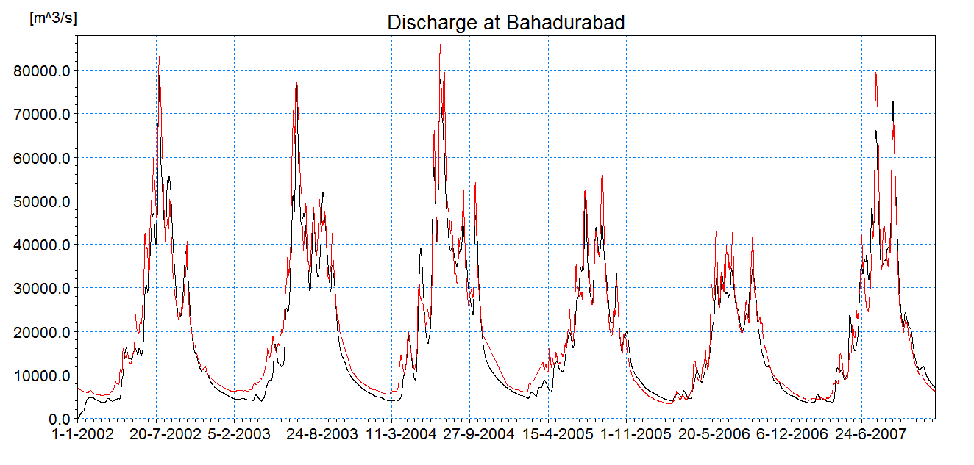
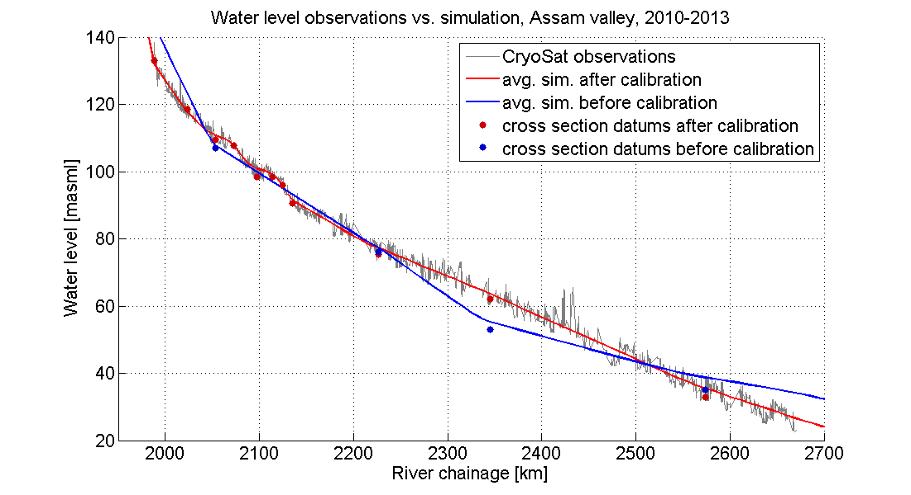
Ganges-Brahmaputra Mike-11 model: first results
Red: observed: Black: Simulated
Nash-Sutcliffe coefficient: 0.94 Percent Bias: - 5%
Fitting the average profile
Notes:
-The left-hand chart demonstrates the performance of the model in the calibration period. This is a very good performance for this type of model.
-The right-hand chart shows CryoSat2 observations (mainly SARIN, processed by DTU Space in LOTUS) along the Brahmaputra river (black lines). The blue line is the temporal average of the open water surface as simulated by the model before adjustment. The red line is the temporal average of the open water surface as simulated by the model post adjustment. The message is that Cryosat2 delivers useful data that can improve a model even if it does not come as virtual station time series.

Slide 15
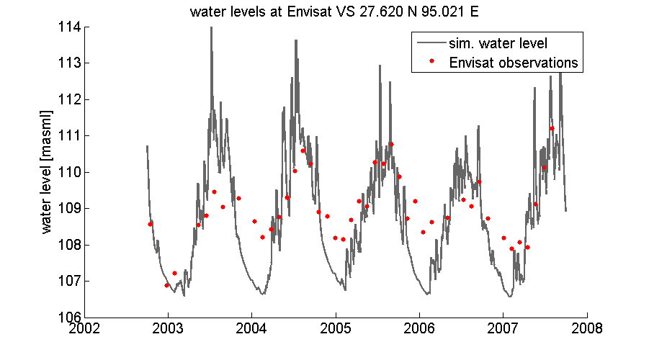
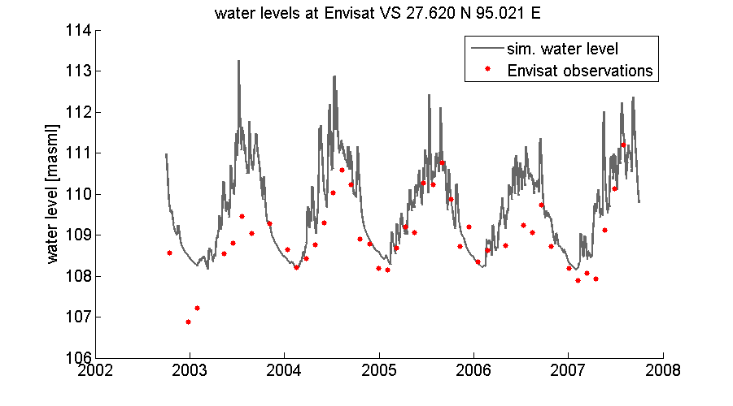
Fitting the amplitude
Pre-adjustment
Post-adjustment
Adjusted parameters: Bank slope and River width
Virtual station data useful to constrain water-level discharge relationship
CryoSat-2 data useful to obtain average water level profile
Suggested workflow for combined use of all altimetry
Set up and calibrate hydrologic-hydrodynamic model
Adjust cross section elevations by comparing average simulated water level with CryoSat-2
Adjust cross section geometry by comparing simulated water level with virtual station time series
Assimilate real-time altimetric heights to hydrodynamic model
Notes:
This slide has two parts:
-The upper part shows that while Cryosat2 can be used to constrain channel slope, virtual station data (Envisat etc) can be used to adjust cross-section geometry and/or Manning roughness. We chose bank slope and river width as adjustment parameters.
-The second part is the concluding message on the hydro work. This is the overall workflow we suggest for using multi-mission altimetry with hydro models.

Slide 16
Conclusions:
BER1 retracker created and designed for SAR inland water echoes
Excellent results, will proceed with this development
Waveform shape filtering CRITICAL for SAR waveforms as so many exhibit multi-target responses
Protocol for waveform filtering developed and tested, works well
Preliminary SAR FBR processing for inland water heights
Hydrologic modelling approach developed (based on virtual station approach as CryoSat-2 orbit non-repeating)

